Slide 1
“Title of the Project” Batch No. ___
By
Student Name : USN
Student Name : USN
Under the Guidance of
Prof/Dr. Name of Guide here..
Department of Computer Science and Engineering
KLS, GIT, Belgaum
Academic Year – 2018-19

Slide 2
1. Problem Statement 2. Requirement Specifications 3. Design – Details 4. System Architecture 5. Project work – Progress 6. Future Plan
Table of Contents

Slide 3
Problem Statement : Two to three lines.. Indicating what objectives your project would achieve … Example : ( Note this is only a sample.. To illustrate ) Problem Statement : To design and develop a software system to classify the customers of bank as potential defaulters using machine learning techniques.
Project Title

Slide 4
Functional Requirements 1. 2. 3. 4….. Non-Functional Requirements 1. 2.
Requirement Specifications

Slide 5
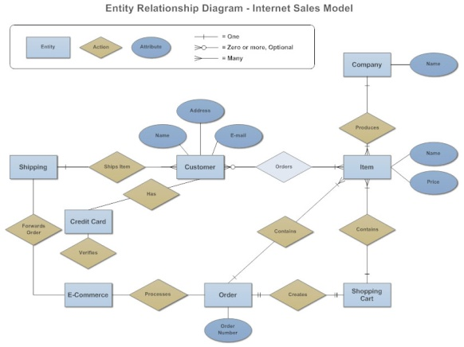
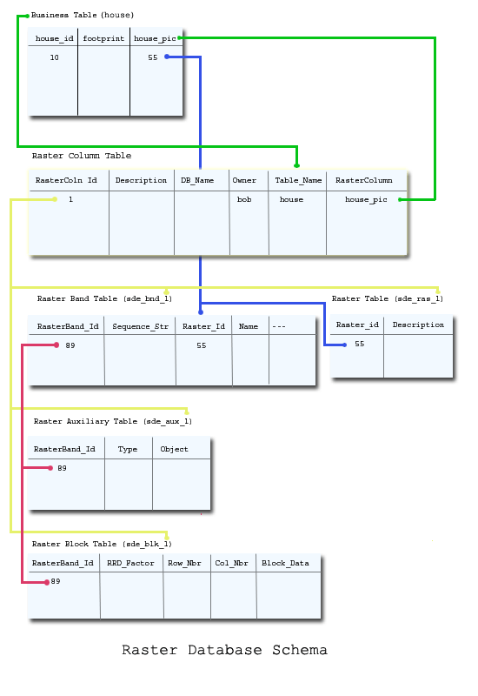
1. ER-Model ( ER-Diagram ) 2. Schema Diagram 3. Normalization ( Upto – 3 NF atleast…)
Design Details ( Use free tools like Dia or StarUML to draw following diagrams )
Database Design ( If Applicable…. i.e. if you are using any Database for storing project related data)

Slide 6
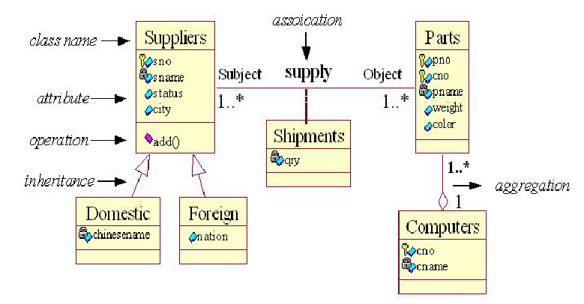
1. Class Diagram – If code is developed using OOPS 2. Important Modules ( Identified by you to meet the functional requirements…) 3. Any important Algorithms implemented/Used and their interaction with your code…
Design Details ( Use free tools like Dia or StarUML to draw following diagrams )
Software Design - Breaking down customer requirements into functional blocks….

Slide 7
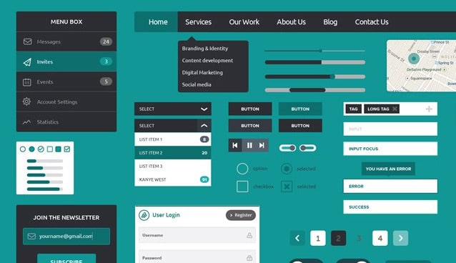
Hint: Imagine how the GUI would look like when the final product is ready and roughly draw the diagrams
Design Details ( Use some free tools… )
GUI Design - Planned User Interface Design…. ( One or Two UI samples… )

Slide 8
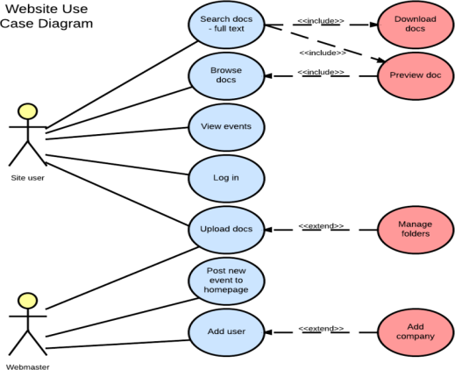
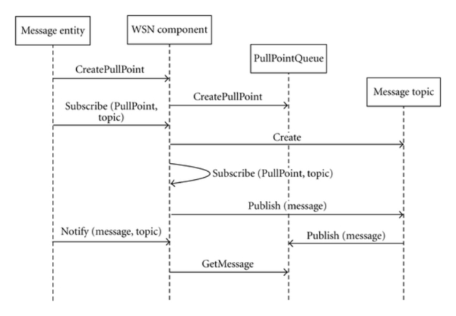
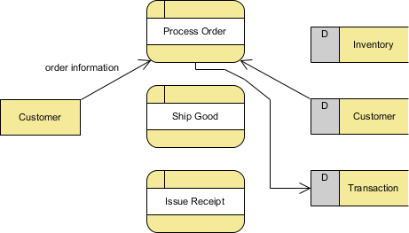
1. Use Case Diagrams ( 2 to 3 ) 2. Sequence Diagrams (1 or 2) 3. Data flow diagrams ( 1 or 2 if applicable) 4. Any other… as applicable to your project
Other Software Artifacts

Slide 9
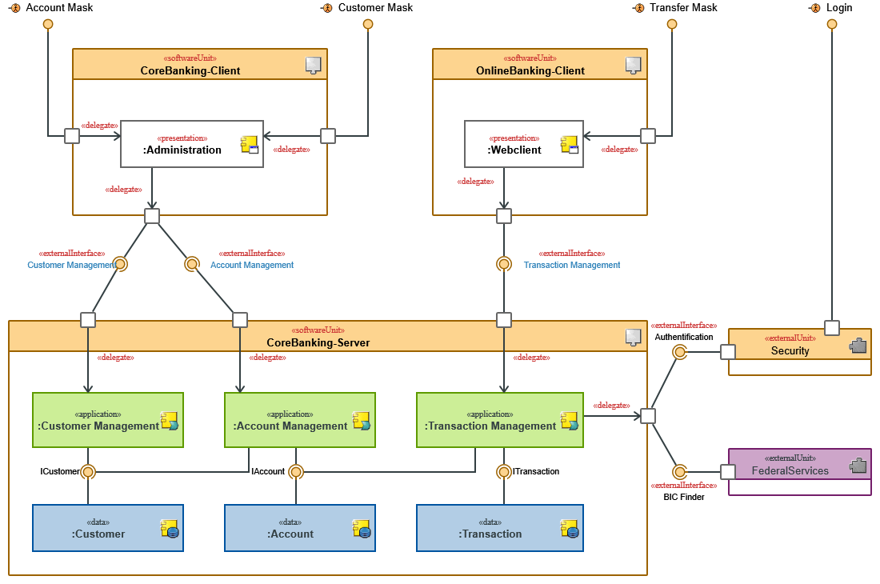
Diagram showing different functional blocks and their interaction with each other Sample Diagram…. Shown below..
Software Architecture

Slide 10
Programming Language : Java/C/Python/C# or any other Web Technologies ( If applicable ) : JSP/ASP/PHP/ any other…. Operating System : Windows/Linux/MacOS Mobile Platforms (If applicable ) : Android/iOS Cloud Platforms used : If yes, Azzure/AWS etc.. Development IDE : NetBeans/Eclipse/VisualStudio/Android Studio
Software Platforms and Development Tools Identified

Slide 11
Rasbery – PI, Aurdino board or Any others – Specifications Show the images of the same.. Here… Sensors if any -- Technical Specifications Show the images here….
Hardware Platforms and Development Tools Identified

Slide 12
1. Problem Statement & Title Finalized - Yes/No 2. Functional, Non-functional Requirements – Identified Yes/No 3. Design – Database, Class/Module, GUI Complete/Incomplete 4. Code – Modules Developed Done/PartlyDone/Yet to Begin 5. Future Plan of Action Ready/Not Ready In the Gantt Chart -- Show 1. Literature/Product Survey 2. Problem Statement and Requirement Specs 3. Design – Details 4. Identify and Design Implementation modules 5. Coding and Testing 6. Report Writing Refer to next slide for Gantt Chart diagram…
Project Work Progress

Slide 13
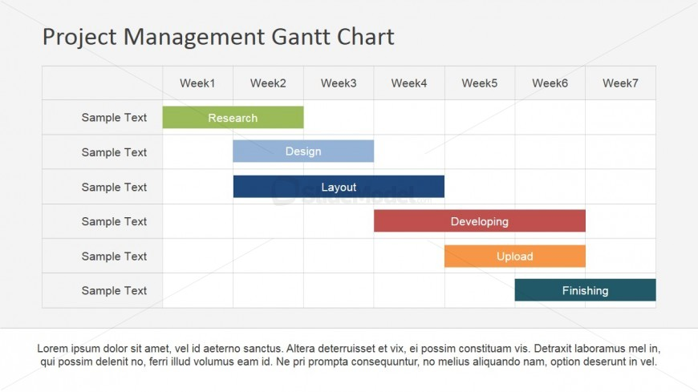
Instead of Weekly show monthly plan starting from Zeroth Phase Eval. Done last semester
Project Work Progress ( Use a tool to draw Gantt chart for your project )

Slide 14
References
Books ( Author/s,title, publisher, year)
E-resources (Author/s, url, date of reference)
Journal Papers ( Authors, Title

Slide 15
Questions ?

